Slide 1


CentOS 7 server hardening
By Tan Jia Shun (S10198161D)

Slide 2
Why CentOS 7
One of the most stable Linux OS
More secure
Active long term support
Support cPanel
Recommended for business owner

Slide 3
My best practices
Use Strong and Unique Passwords
Update Your Software Regularly (Not auto update)
Remove any unused software
Disable any external device slot

Slide 4
My best practices
Close any unused ports
Disk Encryption
Give user the least privilege
Prepare for any attack

Slide 5

Remove any unused software/Close any unused ports
Installed CentOS 7 Minimal
Installed minimal of software needed
All firewall port is block by default
SSH port is changed to: 2200

Slide 6
Update Your Software Regularly
Do not set auto update
The update may break the server
Check update log before update
Use “yum check-update”
Update manualy when comfirm update is safe
Use “yum update [software name]”

Slide 7
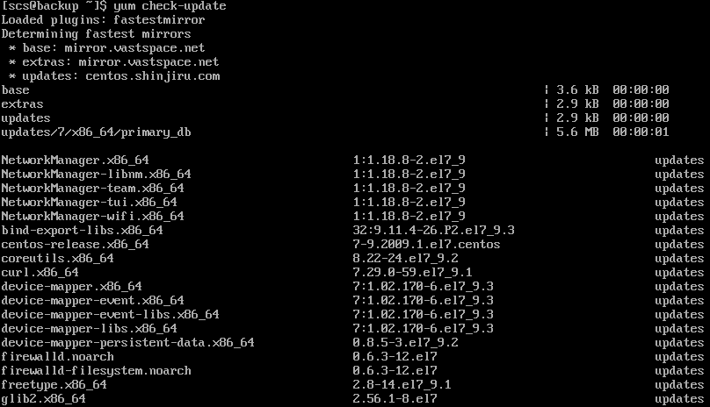
Update Your Software Regularly

Slide 8
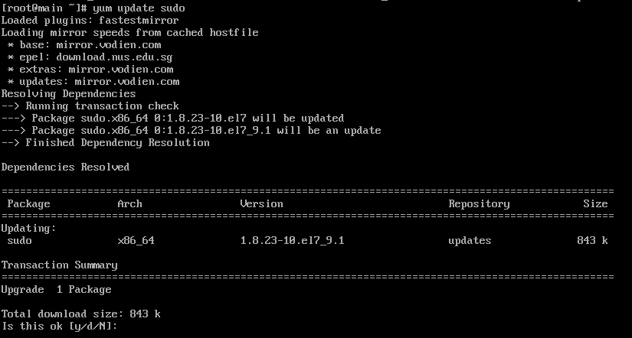
Update Your Software Regularly

Slide 9
Strong and Unique Passwords
Having strong and unique password
Harder to crack using burte force attack
Password may not be in the burte force password list
It take longer time to crack using blind burte force attack

Slide 10
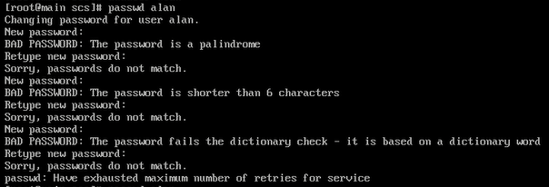
Strong and Unique Passwords
User password policy
Password should be minimum 8 value long
Must have 1 number
Must have 1 lower-case
Must have 1 upper-case
Must have 1 symbol
Cannot use password from the last 3 time
Done in: /etc/security/pwquality.conf

Slide 11
Strong and Unique Passwords
User password age
Make user change password regularly
Make attacker harder to guest our password
Pwned password may not work

Slide 12
Strong and Unique Passwords
User password age
Need change password every 30 day
Warn user to change 7 day before hand
Done in: /etc/login.defs

Slide 13
SSH Protection
2FA for SSH
Google authenticator
Must key 2FA key when login on SSH
Accept only the current and the previous code
Done in/etc/pam.d/sshd
Root user is disable on SSH
Harder to gain privilege
Done in: /etc/ssh/sshd_config

Slide 14
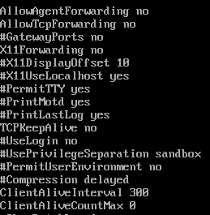
SSH Protection
Others
Max login try: 4
Forwarding disabled
ClientAliveInterval: 300

Slide 15
User management
Give user the least privilege
Giving different file permission to different user and group
Using chown and chmod

Slide 16
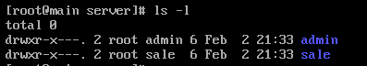
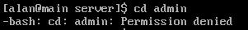
User management
Permission set:
When a user with no permission try to access:

Slide 17
Disable any external device slot
To disable attack that have access to the server physically
Block USB port on /etc/modprobe.d/blacklist.conf
Only people with privilege can enable the port
If possible, buy a physical USB blocker to block all USB port
Remove any CD rom

Slide 18
Prepare for any attack

Slide 19
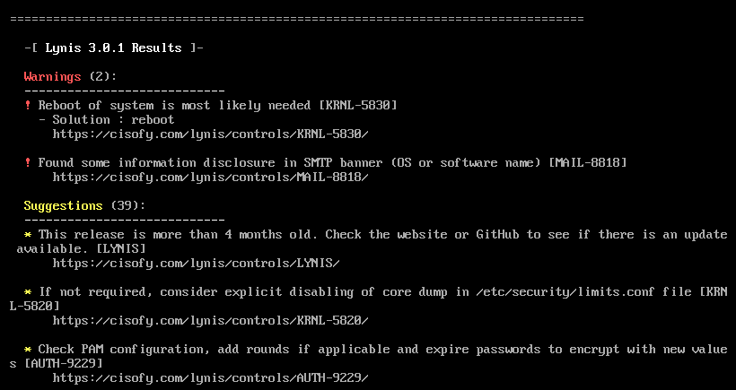
Audit & vulnerability scan
Lynis
Able to scan for vulnerability
Create a detail report and logging of system

Slide 20
Anti-virus
Linux Malware Detect (LMD)
Malware scanner
When found any malware, an email will be sent to the administrator
ClamAV
Malware detector

Slide 21
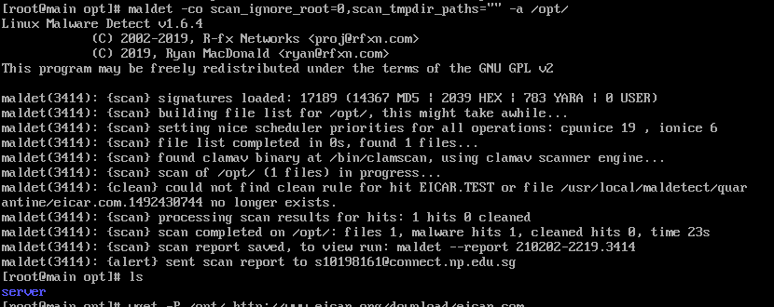
Anti-virus

Slide 22
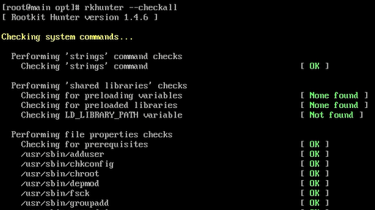
rkhunter
Rootkits and general vulnerabilities scanner
Command: rkhunter --checkall

Slide 23
Disk Encryption
To protect the data on the server when:
Server is stolen
Forget to clean the disk when disposing it

Slide 24
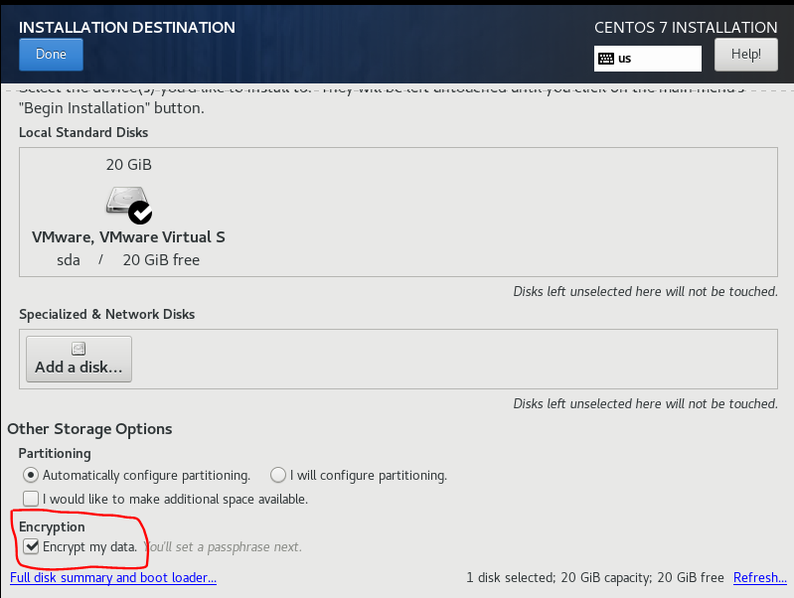
Disk Encryption
It is set during the setup of centos OS process

Slide 25
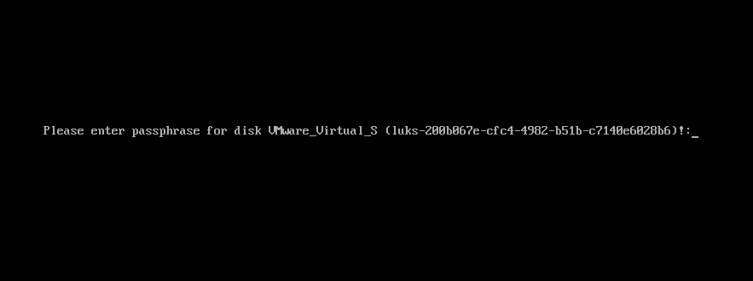
Disk Encryption
It will prompt a passphrase before the OS boot up
It will only decrypt and boot the OS if the passphrase is correct

Slide 26
Folder backup
Able to backup important file to a backup server
To protect the data in case any data corruption or attack happen
Done using rsync

Slide 27
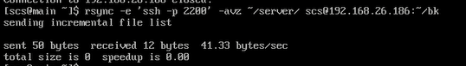
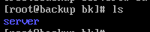
Folder backup
Command to backup the server
Result on the backup server:

Slide 28
Reference
https://www.thesslstore.com/blog/linux-server-security-linux-hardening-best-practices/
https://linuxtechlab.com/disable-usb-storage-linux/
https://www.techrepublic.com/article/how-to-set-up-two-factor-authentication-on-centos-7/
https://www.thegeekdiary.com/how-to-open-a-ports-in-centos-rhel-7/
https://www.a2hosting.sg/kb/getting-started-guide/accessing-your-account/disabling-ssh-logins-for-root
https://geekflare.com/no-internet-connection-from-vmware-with-centos-7/
https://www.hostinger.com/tutorials/centos-vs-ubuntu#:~:text=The%20biggest%20difference%20between%20the,from%20Red%20Hat%20Enterprise%20Linux. &text=CentOS%20is%20considered%20to%20be,package%20updates%20are%20less%20frequent.
https://www.server-world.info/en/note?os=CentOS_7&p=password
https://www.tecmint.com/install-linux-malware-detect-lmd-in-rhel-centos-and-fedora/
Linux King: https://www.youtube.com/watch?v=ZfvpOVmbWwA
https://www.tecmint.com/sync-files-using-rsync-with-non-standard-ssh-port/
https://linuxhint.com/add_user_to_group_centos_7/

Slide 29
THANKS!

